Slide 1
PROCESSING OF FILMS

Slide 2
CONTENTS
Film processing
Composition of developer solution
Composition of fixer solution
Dark room equipments
Safe lighting
Practical processing methods
  Manual
  Automatic
  Self Developing Film

Slide 3
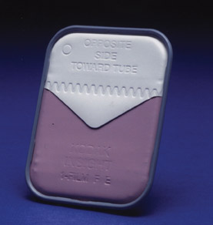
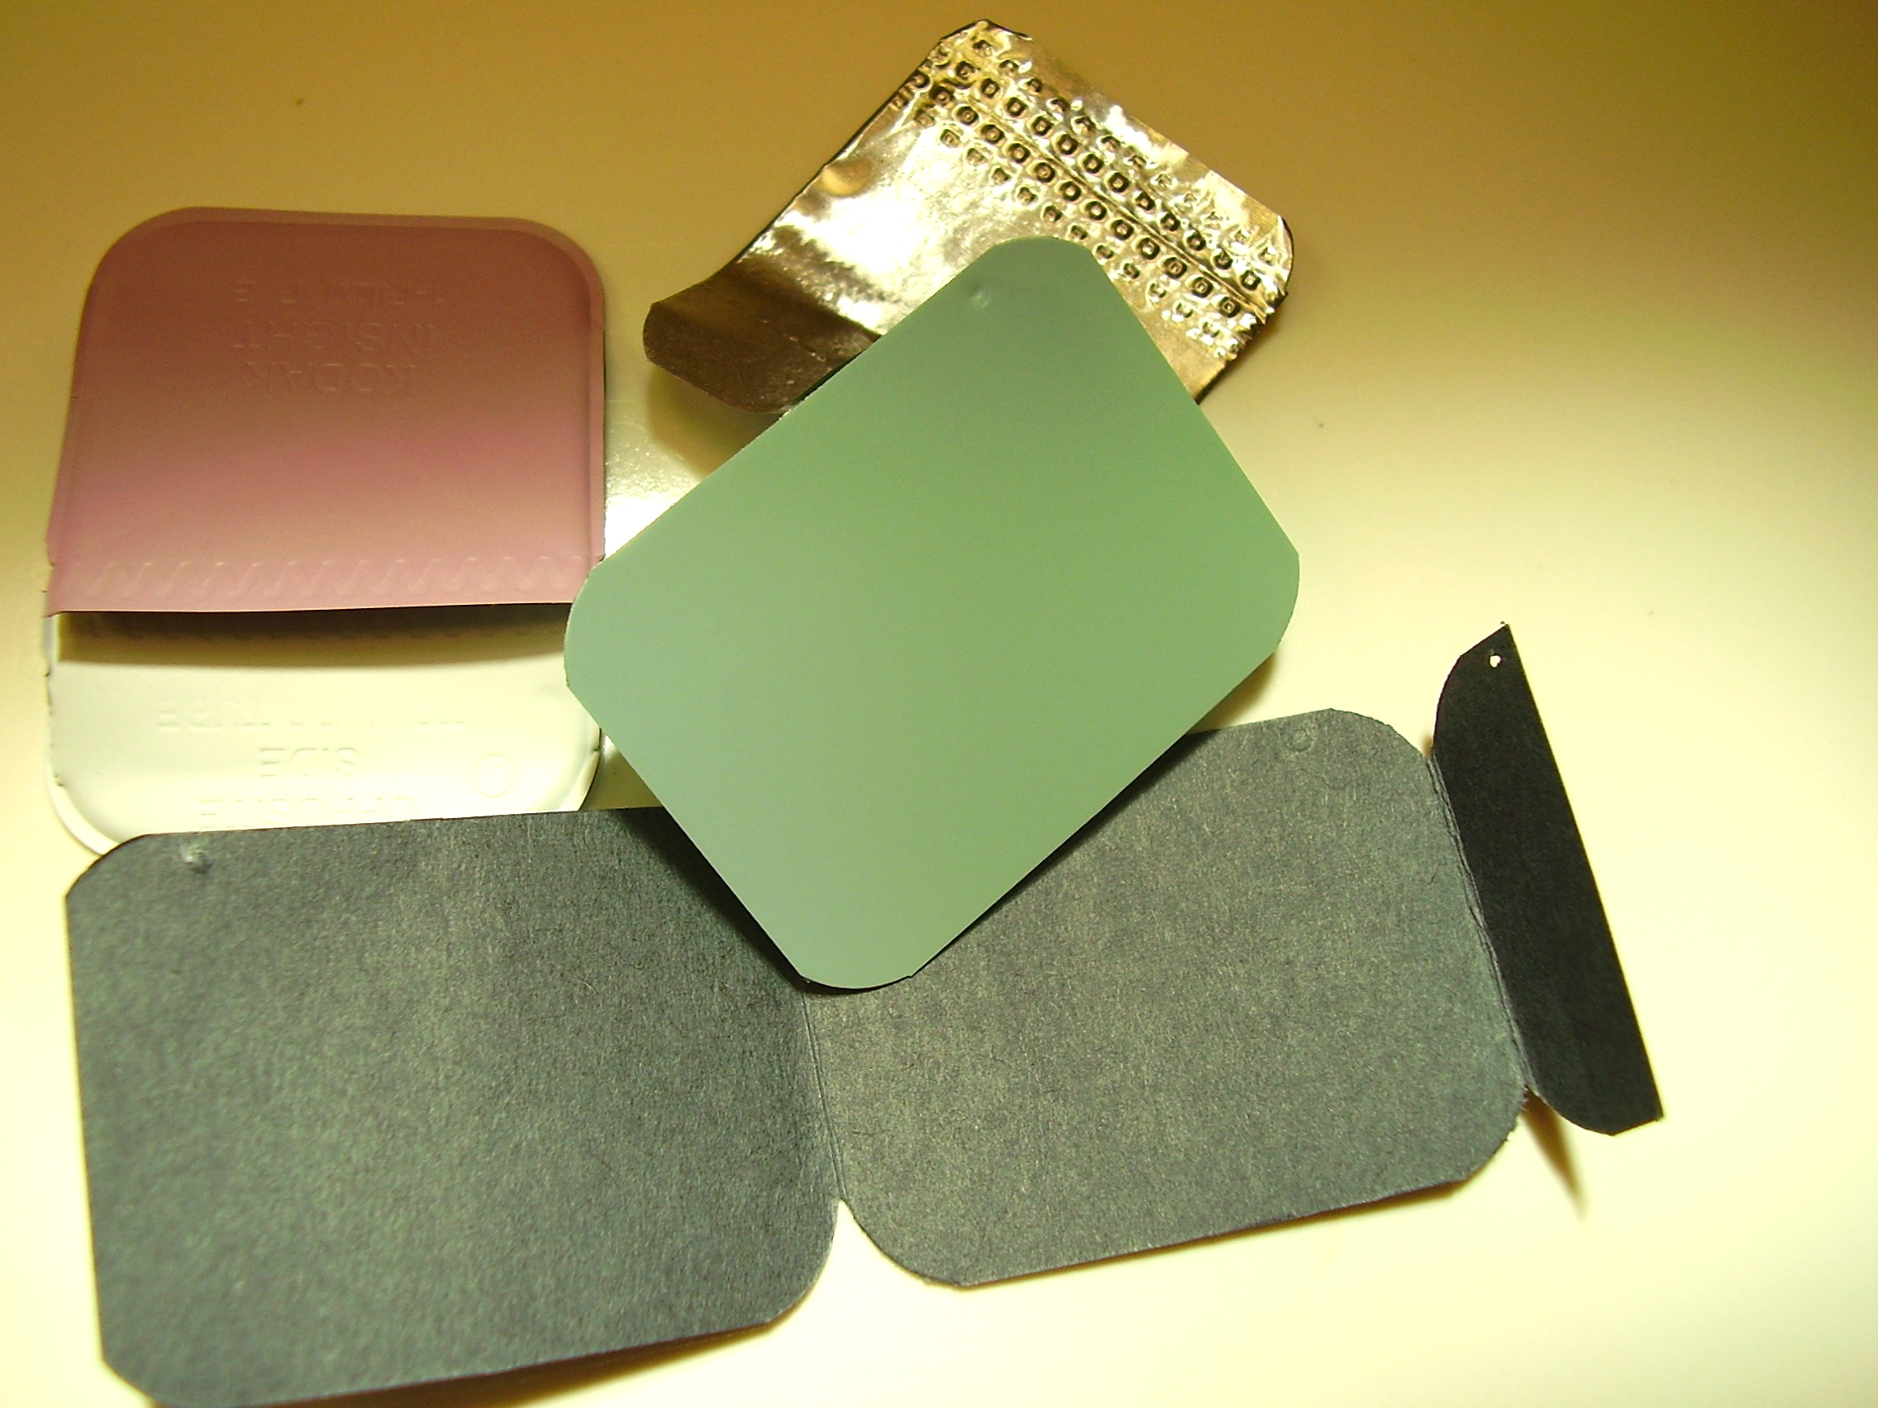
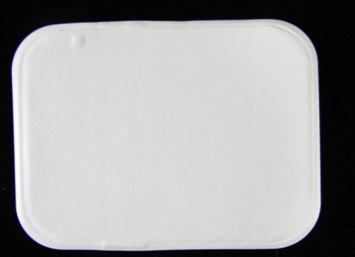

Slide 4
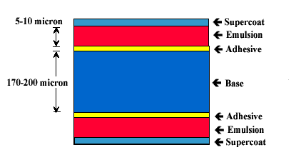
Base
0.2mm thick
Polyester Polyethylene Teraphthalate
Emulsion
Silver Halide Grains
Vehicle Matrix.

Slide 5
PROCESSING;- is a collective term for series of operations which bring about chemical changes in an exposed film thus making the image visible & permanent.

Slide 6
The purpose of film processing is two fold
  To convert the latent image (invisible) on the film into a visible image
  To preserve the visible image that it is permanent and does not disappear from the dental radiograph

Slide 7
After the films are exposed to radiation, they need to be processed in order to see the information on the film. This processing is done using special chemicals and takes place in a darkroom.

Slide 8
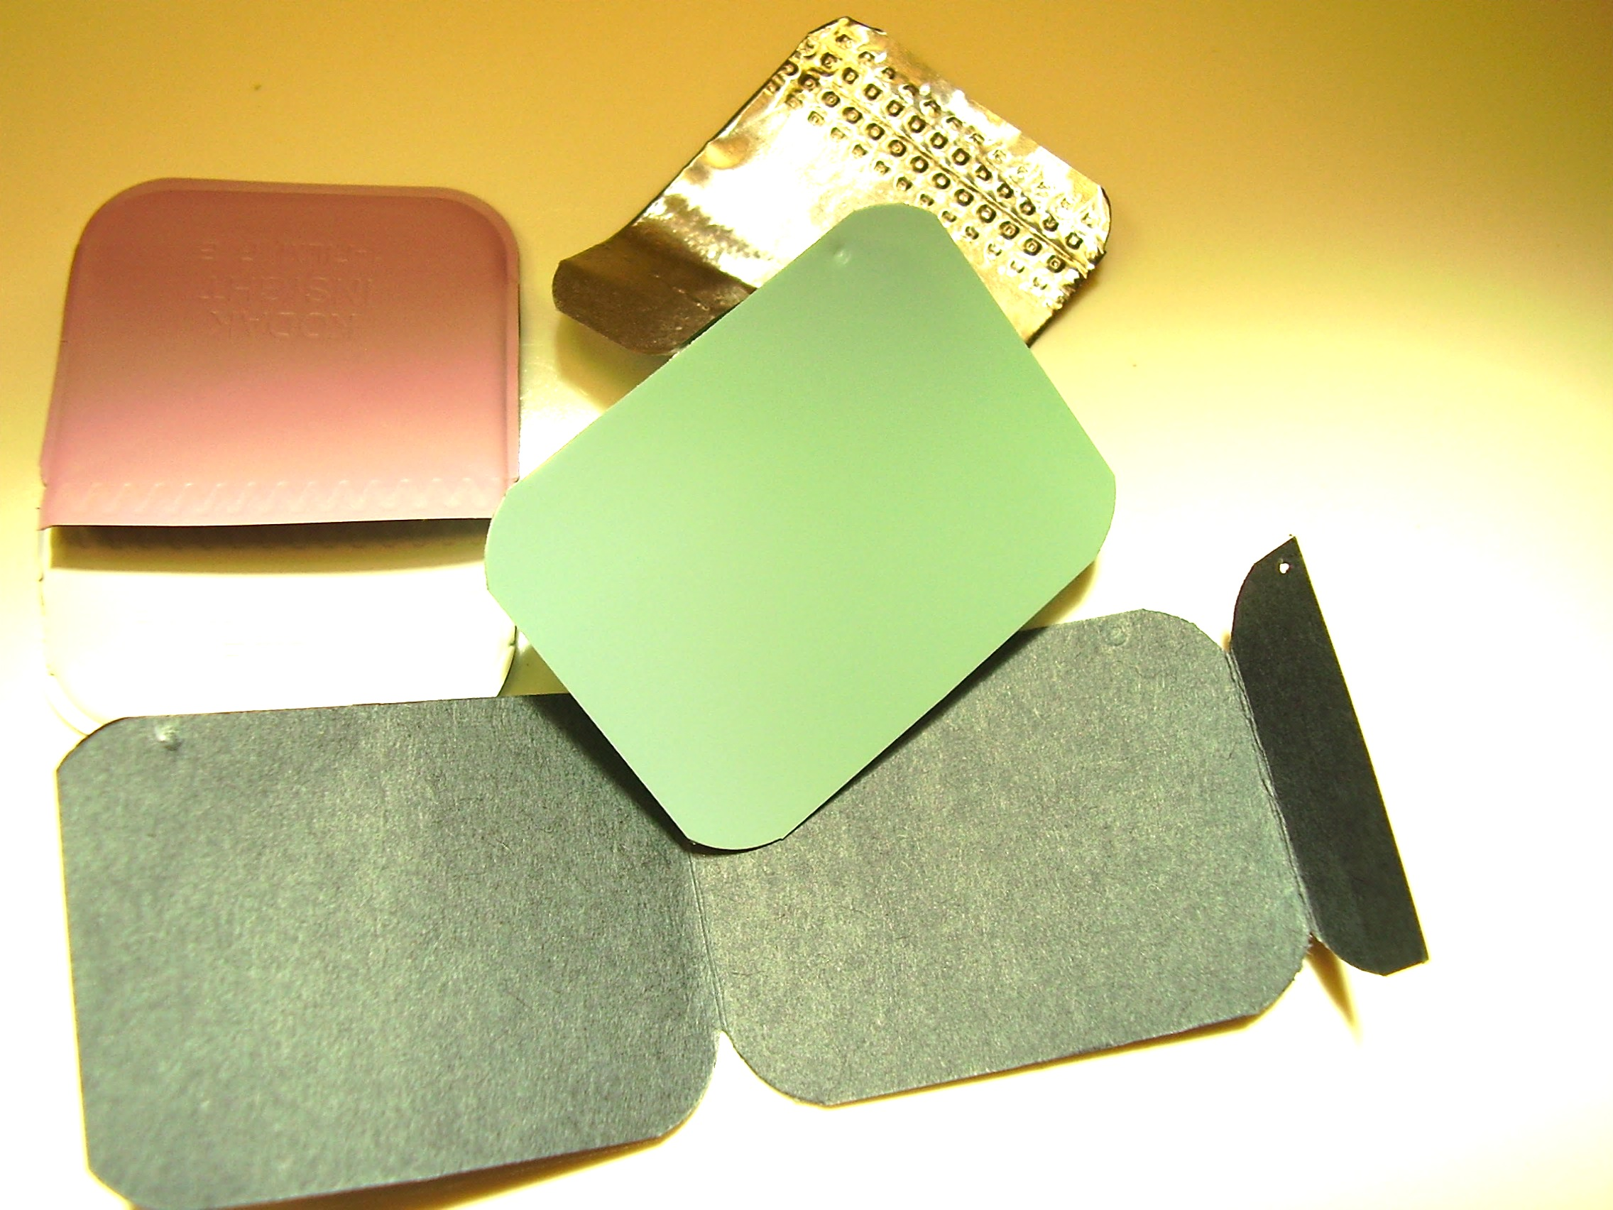

Slide 9
The darkroom should have the following attributes:
It must be light-tight. Since the silver halide crystals are sensitive to both x-rays and light, the area where films are processed must be completely dark, except for a safelight.

Slide 10
After exposure latent image formed.
FORMATION OF LATENT IMAGE
Silver halide crystals in the emulsion absorb x-radiation during x-ray exposure and store the energy from the radiation, which forms a pattern and creates an invisible image within emulsion on the exposed film. This is called as Latent Image

Slide 11
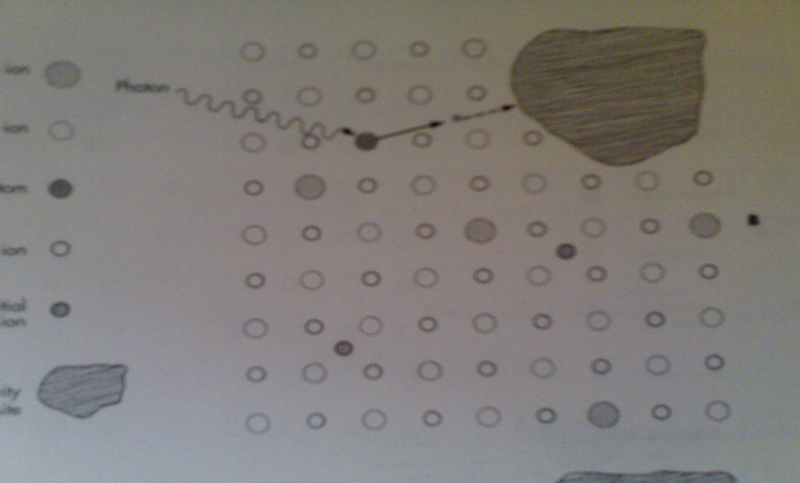
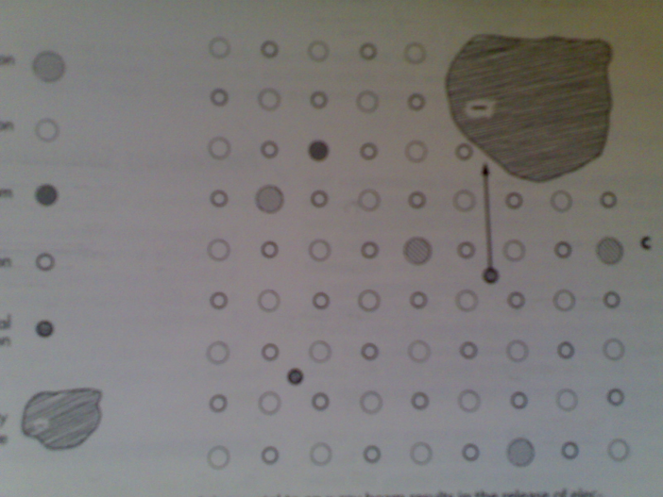
Latent Image Formation
Removal of an e- from bromide ions
Bromide ion Bromine
Free e- Sensitivity Site
Here e- imparts –ve charge
Silver ion+sensitivity site
Neutral Metallic Atom

Slide 12
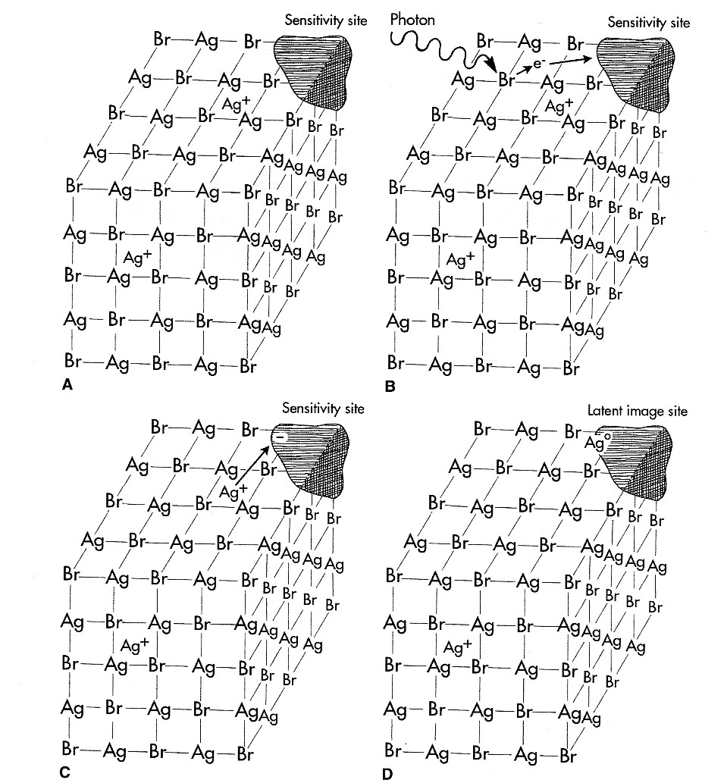
A
B
C
D

Slide 13
SCHEMATIC PRESENTATION OF EMULSION
BEFORE EXPOSURE
AFTER EXPOSURE

Slide 14
Made up of black, white and grey areas
RADIOLUCENT
Radiolucent structure is one that readily permits the passage of the x-ray beam and allows more x-rays to reach the film
If more x-ray reach the film , more silver halide crystals in the film emulsions are exposed and energized, resulting in increased deposit of black metallic silver, through appear more black or radiolucent

Slide 15
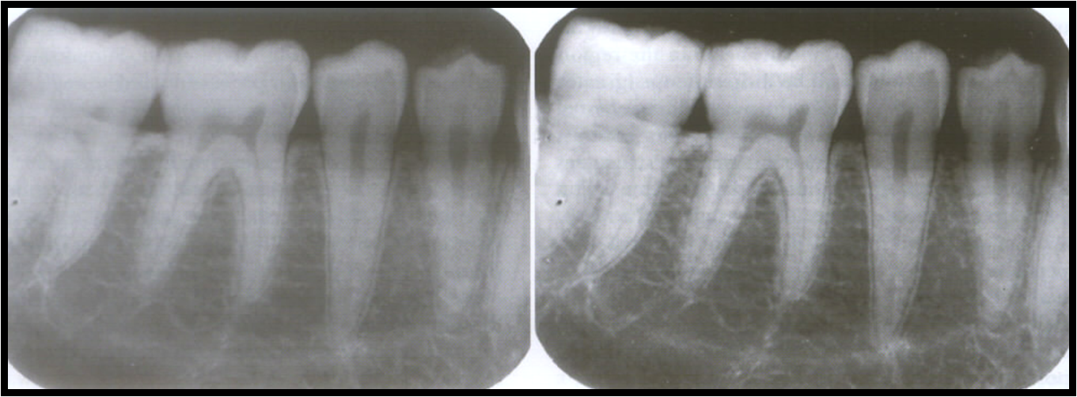

Slide 16
RADIOOPAQUE
Radioopaque structure is the one that resists the passage of the x-ray beam and restricts or limits the amount of x-rays that reach the film
If no x-ray reach the film, no silver halide crystals are exposed, and no deposits of black metallic silver ions are seen
The unexposed silver halides crystals are removed during processing, therefore structure are white or radioopaque

Slide 17

Latent Image
0
Air/soft tissue
Bone
Amalgam/gold
Many x-rays penetrate and expose many silver halide crystals
Fewer x-rays penetrate and not as many silver halide crystals are exposed
Few, if any, x-rays penetrate; silver halide crystals not exposed
= Exposure centers

Slide 18
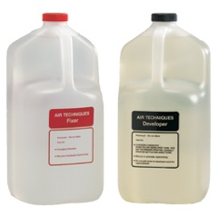
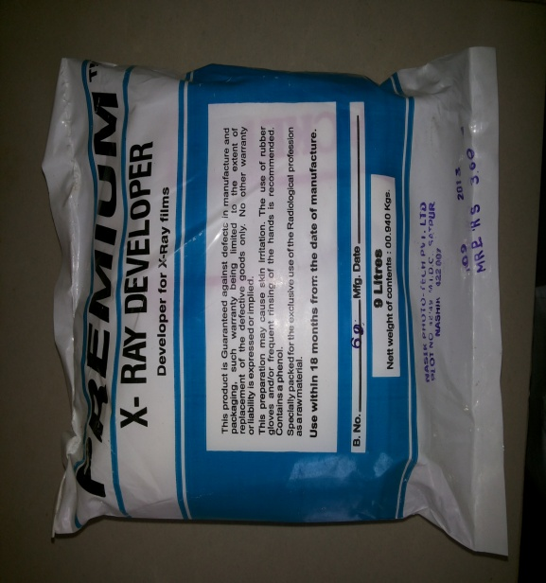
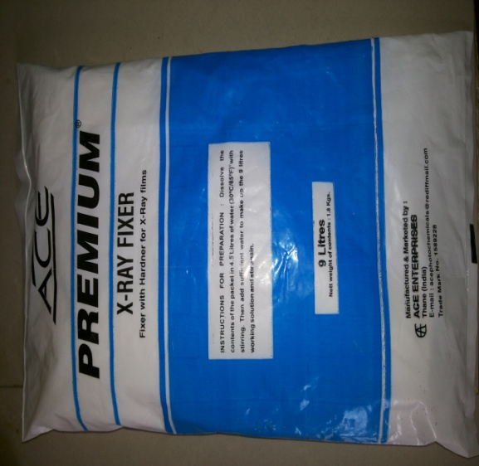
PROCESSING SOLUTIONS
SOLUTIONS are available
In powder ,ready to use liquid, liquid concentrate

Slide 19
Processing Solution
Developer
Fixer
Action of developer:
The action of the developing solution is to convert (reduce)the exposed silver halide grains to metallic silver.
The sensitivity speck contains silver atoms .
When the developing solution contacts the silver ,it denotes electrons to neutralize positive silver ions allowing further silver ions to get attached to the speck.

Slide 20
These silver ions are neutralized to metallic silver until the whole crystal has become metallic silver .
The negative bromine ions which formed the crystal lattice with positive silver ions are dispersed in to the developer solution as free bromine ions as the silver ions are no longer available for keeping them.

Slide 21
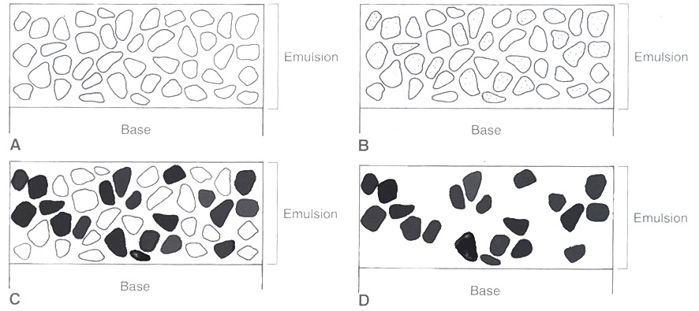
EMULSION CHANGES DURING FILM PROCESSING
A- Before exposure, many silver bromide crystals are present in the emulsion.
B- After exposure, the exposed crystals containing neutral silver atoms at latent image sites constitute the latent image (shaded areas in the crystals).
C- The developer converts the exposed crystals containing neutral silver ions
D- unexposed, undeveloped silver bromide crystals are removed leaving only the solid silver grains

Slide 22
Developing
0
Development centers in crystals struck by x-rays are converted into black metallic silver
Air/soft tissue
Bone
Amalgam/gold

Slide 23
Developing (continued)
0
Entire crystal converted to black metallic silver
Air/soft tissue
Bone
Amalgam/gold

Slide 24
COMPOSITION:4 components
1.developer
2.activator
3.preserative
4.restrainer

Slide 25
DEVELOPER
ACTION :
To Reduce all the silver ions in the exposed crystals of silver bromide to metallic silver
Reduction process must be restricted to those crystals containing a latent image.
The areas that have larger proportion of exposed crystals will be the more dense

Slide 26
Developer – reducing agent
- purpose is to convert exposed silver halide crystals in to metallic silver grains
Contains Two Developing Agents
REDUCING AGENTS:
-
ELON- MONOMETHYL PARA AMINOPHENOL SULPHATE
HYDROQUINONE – PARAHYDROXY benzene

Slide 27
PRESERVATIVE
SODIUM SULPHITE
  antioxidant
  Has greater affinity for oxygen and
  Protect the developer from being oxidized by atmospheric oxygen
  Helps extend the useful life of hydroquinone and elon

Slide 28
ACCELERATOR / ACTIVATOR
The developer agent are active only in alkaline –high pH – medium (pH - 11)
To maintain this condition, they contain alkali which serves as an activator (accelerator)
SODIUM CARBONATE, SODIUM HYDROXIDE AND SOMETIMES SODIUM METABORATE, SODIUM TETRABORATE

Slide 29
When developing agents reduces silver halide granules H+ produced which causes fall in pH and depress the reduction of silver that is slow developing process, therefore activator is used to fasten the process
Also serve to soften the gelatin so that developer agent can diffuse more rapidly into this emulsion

Slide 30
RESTRAINER
POTASSIUM BROMIDE
Added because bromide is a product of reduction of silver halide crystals and added bromide serves to depress the reduction by common ion effect
Although it dose depress the reduction of both the exposed and unexposed crystals, it is much more effective in depressing the reduction of unexposed crystals, so as a consequence acts as an ANTIFOG AGENT

Slide 31
Developer Replenisher
30 periapical or 5 panoramic films
8 ounces of fresh developer per gallon of developing solution.
In order to replenish the solution some amount of old solution is to be discarded.
Care should be taken in handling the solutions and proper temperature should be maintained.
Notes:
1 ounce =29.6 ml
8 ounce =236 ml

Slide 32

IF DEVELOPER IS
COLD: Action is slow
Time taking
WARM: Quick
Short time
Uneven Development
Excessive Fog
AT VERY HIGH TEMPERATURE:
Emulsion is excessively softened.

Slide 33
FIXING SOLUTION
Function is to remove the unexposed silver halide crystals from the emulsion
Presence of unexposed crystal cause the film to be opaque if not removed will cause the film to be obscured and non diagnostic
The other function of fixer is to hardened the emulsion (on the film)

Slide 34
EMULSION CHANGES DURING FILM PROCESSING
A- Before exposure, many silver bromide crystals are present in the emulsion.
B- After exposure, the exposed crystals containing neutral silver atoms at latent image sites constitute the latent image (shaded areas in the crystals).
C- The developer converts the exposed crystals containing neutral silver ions
D- unexposed, undeveloped silver bromide crystals are removed leaving only the solid silver grains

Slide 35
Fixing
0
In the fixing solution, the unexposed silver halide crystals are removed from the film by the fixing solution.
Air/soft tissue
Bone
Amalgam/gold

Slide 36
Composition OF FIXER
Composition-4components
1.clearing agent.
2.acidifer.
3.preservative.
4.hardner

Slide 37
CLEARING AGENT
Fixing agent
Aqueous solution of SODIUM THIOSULPHATE or AMMONIUM THIO SULPHATE
Function is to remove the unexposed and underdeveloped silver halide crystals from the film emulsion
The chemicals clears the film so that the black image produced by the developer become readily distinguished

Slide 38
ACIDIFIER
ACETIC ACID OR SULPHURIC ACID
The purpose is to neutralizes the alkaline developers
Also produces necessary acidic environment for fixing

Slide 39
PRESERVATIVE
SODIUM SULPHITE
To prevent chemical deterioration of the fixing agent

Slide 40
HARDENING AGENT
POTASSIUM ALUM
To harden and shrink the gelatin in the film emulsion after it has been softened by the accelerator in developer solution
Shortens the drying time

Slide 41
EMULSION CHANGES DURING FILM PROCESSING
A- Before exposure, many silver bromide crystals are present in the emulsion.
B- After exposure, the exposed crystals containing neutral silver atoms at latent image sites constitute the latent image (shaded areas in the crystals).
C- The developer converts the exposed crystals containing neutral silver ions
D- unexposed, undeveloped silver bromide crystals are removed leaving only the solid silver grains

Slide 42

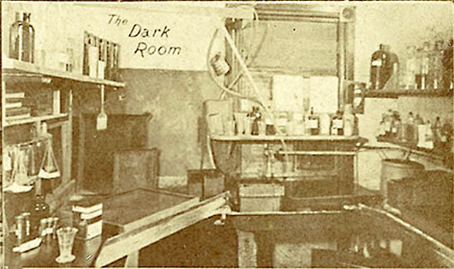
DARK ROOM

Slide 43
DARK ROOM EQUIPMENTS
Primary function is to provide a completely darkened environments, where x-ray film can handled and processed to produces diagnostic radiograph

Slide 44
REQUIREMENTS
Conveniently located Of adequate size (16-20 sq feet)
Equipped with correct lighting arranged with ample work space and storage
Temperature and humidity controlled
Room should be well ventilated
Light proof
Door should have locks to prevent accidental opening

Slide 45
LOCATION SIZE
Location must be convenient and near to the area where x-ray units are installed
Large enough to accommodate film processing equipments and to allow ample working space
Measured at least 16-20 square feet

Slide 46
LIGHTING
Room must be completely dark and must exclude all visible white light
LIGHT TIGHT – completely dark room
LIGHT LEAKS –light leaks into dark room
  - May cause film fog
Tow types of lighting
  Room lighting
  Safe lighting

Slide 47
ROOM LIGHTING
Incandescent room lighting is required for procedure not associated with the act of processing film.
Required for other tasks like cleaning, stocking materials mixing chemicals

Slide 48
SAFELIGHTING
Special type of light that is used to provide illumination in the dark room during processing
Low intensity light composed of long wave lengths in the red –orange portion of visible light spectrum
Dose not rapidly affect on open film ,but permits one to see well enough to work

Slide 49
Typically consist of a lamp equipped with a low voltage and a safe light filters
Safe light filter removes short wavelength in blue green portion of visible light spectrum that are responsible for exposure or damaging the film .
GBX-2
Intraoral,
extraoral

Slide 50
Safelighting
15 watt bulb
The safelight should have a 15-watt bulb (older style safelight) and be mounted to the wall or ceiling at least 4 feet from the area where the films are unwrapped and loaded into the film processor.
15 W
red filter
4 feet

Slide 51
Coin test or penny test
In order to check for improper safelighting or light leaks, you can perform the following test. Unwrap a film in the darkroom and lay it on the top of the processor. Place metallic (opaque) objects on the film (coins below left) and wait for 3-4 minutes. Remove the objects and process the film. If the film comes out completely clear, everything is OK (below right). If you see the clear images of the metallic objects surrounded by gray, there is a light problem (below middle). Correct as needed.

Slide 52
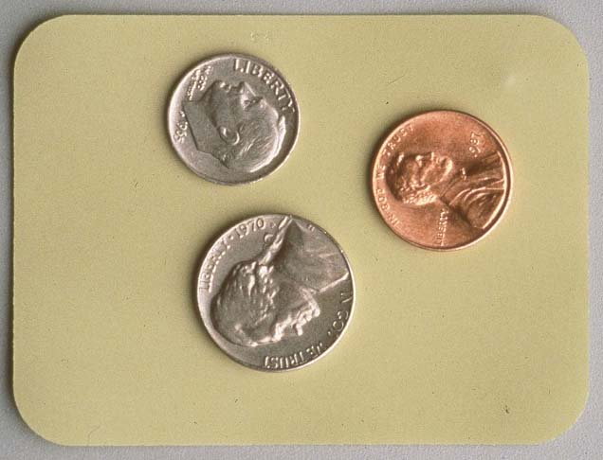
Coin test or penny test

Slide 53
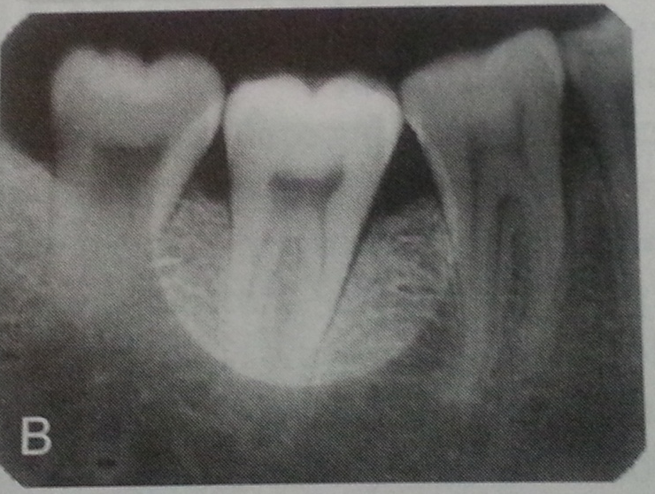
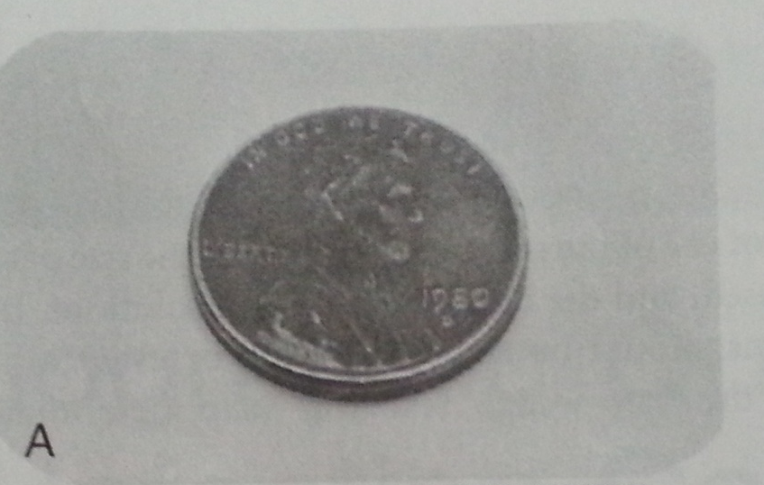

Slide 54

PROCEDURE

Slide 55
film processing involves following steps:
immerse exposed film in developer solution
rinse film in water bath
Immerse film in fixer
Wash film in running water.
Dry film &mount for viewing.

Slide 56
Processing
0
Cold
water inlet
Hot
Mixing valve
Developer
insert tank
Fixer
insert tank
overflow tube
waterbath (large tank)
drain

Slide 57
TYPES OF PROCESSING
1. MANUAL ROCESSING
A) visual processing
B) Time temperature method
2. AUTOMATIC PROCESSING
3. USING SELF DEVELOPING FILM

Slide 58
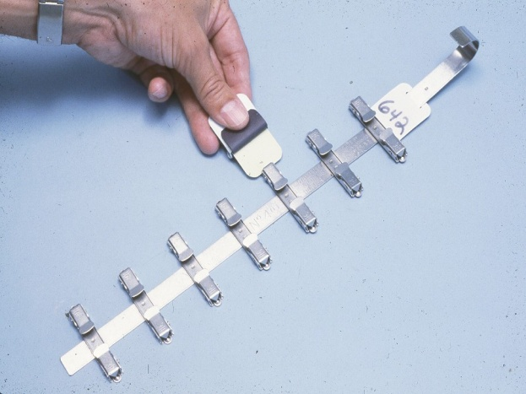
MANUAL ROCESSING

Slide 59
For manual processing, films are clipped to some type of film hanger .
The film should be handled only by the edges to avoid damage. The film hanger, with films attached, is then placed in the processing solutions, developer first.
If the film is inadvertently placed in the fixer first, the film will come out completely clear ; the fixer removes all crystals that have not been converted to black metallic silver by the developer, even if they have exposure centers.

Slide 60
Manual Processing
0
lid
Place hanger with films attached into the developer for 5 minutes. The lid is placed over the tank if you plan to leave the darkroom during development. (Click to complete this action).
The silver halide crystals on the film are converted to black metallic silver in the developer. (Click to see the films change from pink to dark gray).
After removing the lid, place the films in the rinse water and continuously agitate for 30 seconds. Next put the films in the fixer for 4 minutes and agitate for 5 seconds every 30 seconds. (Click to complete these actions)
Remove the films from the fixer and place in the water bath for 10 minutes. (Click to place films in water).
Remove film from the wash water and hang films to dry. (Click to complete action).

Slide 61
MANUAL PROCESSING TIMINGS
Develop 5 minutes at 68 degrees
Rinse 30 seconds (agitate continuously)
Fix 4 minutes (Agitateintermittently;
5 seconds every 30 seconds)
Wash 10 minutes in clean running water
Hang films to dry

Slide 62
A)VISUAL METHOD:the dark room,safe lighting,exposed x-ray film immersed in developing solution and periodically veiwed under safety light for emergence of clear image.
B)TIME TEMPERATURE METHOD:effective standardization achieved without any automatic aids.
Immerse film in developer kept at constant temp for fixed duration.

Slide 63
TEMP
65F
68F
70F
72F
76F
DEVELOPMENT TIME
- 6MIN
- 5MIN
- 4MIN
- 4MIN
- 3MIN

Slide 64
MANUAL PROCESSING;
Advantages:
development under direct control of the operator.
Disadvantage:
time consuming
Requirement of dark room

Slide 65
Automatic Processor
0
Automatic processors come in various shapes and sizes, but they all function the same. The film is inserted in the inlet slot where it is fed into a series of rollers . These rollers transport the film through the developer, fixer, wash and dryer and the film exits the processor ready to mount. The rollers “squeeze” the excess chemicals off of the film as it exits each solution; no rinse is needed between the developer and fixer. (Click to process film).
Film
Exit
Film
Entry
Dryer
(heater, fan)
Developer
Fixer
Wash

Slide 66
dryer
wash
fixer
developer
insert films

Slide 67
Automated Film Processors
Advantages –
Less time consumption – 4 to 6 min.
Need of specialized dark room eliminated
Portable
Disadvantages –
Dificult to maintain
Roller marks are common
Machine problem in middle
Cost

Slide 68
SELF DEVELOPING FILMS
An alternative to manual processing
X-ray film is presented in a special sachet containing developer and fixer
Following exposure, developer tab is pulled, releasing developer solution which milked down towards the film and messaged around it
After 15 seconds the fixer tab is pulled , to release fixer which is also milked down
After fixing the used chemical are discharged , then film is rinsed in water for 10 min and dried

Slide 69
SELF DEVELOPING FILM

Slide 70
ADVANTAGES
No dark room or processing facilities are needed
Time saving –the final radiograph is ready in about 2-3 mints

Slide 71
DISADVANTAGES
  Poor overall image quality
  Image deteriorates rapidly with time
  No lead foil inside the film packet
  Film packet is very flexible and easily bent
  Difficult to use in positioning holder
  Relatively expensive

Slide 72
Radiographic faults due to processing
Light Radiographs
Dark Radiographs
Insufficient Contrast
Film Irregularities
Dark Spots or Lines
Light Spots
Yellow or Brown Stains
Partial Images
Emulsion Peel

Slide 73
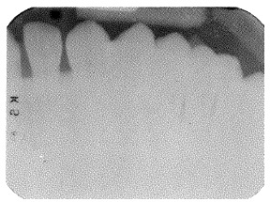
Faulty Radiographs
Light Radiographs –
Underdevelopment
Depleted developer
Contaminated developer
Excessive fixation
Insufficient Contrast –
Under development
Under exposure

Slide 74
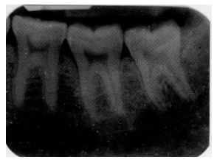
Dark Radiograph –
Over development
High developer concentration
Inadequate Fixation
Accidental exposure to light before developing
Improper safe lighting
Film Fog –
Over development
Contaminated solution
Deteriorated film

Slide 75
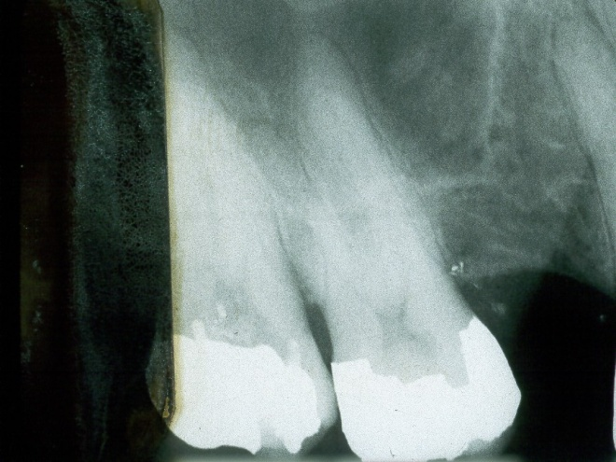
Dark Spots –
Finger print contamination
Black wrapping paper sticking to film
Film contaminated with developer
Excessive film bending
Excessive roller pressure

Slide 76
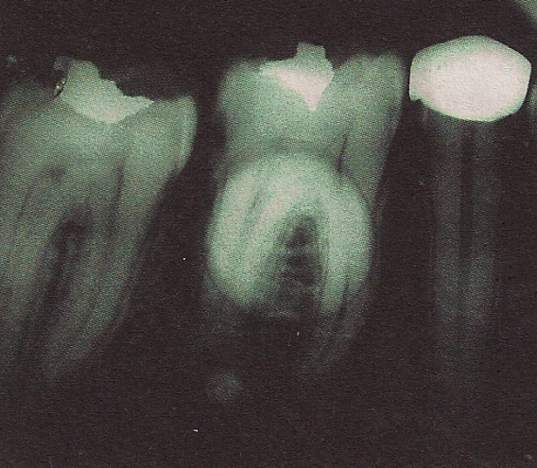
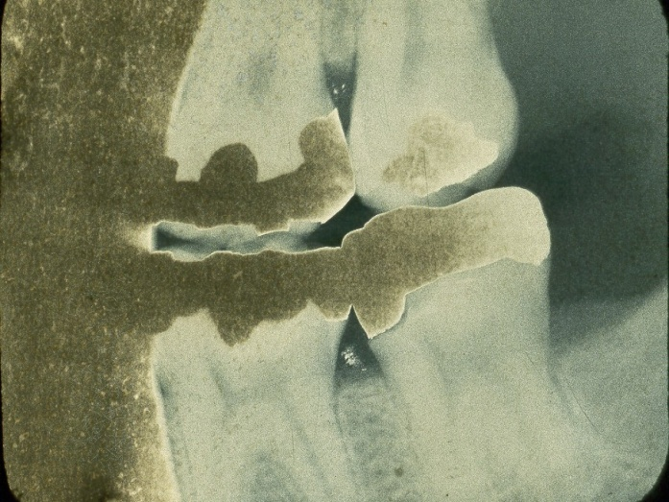
Light Spots –
Film contaminated with fixer
Film in contact with another film during developing
Excessive film bending
Yellow or Brown Stains –
Depleted developer
Depleted fixer
Insufficient washing
Contaminated solution

Slide 77
Partial Images –
Top of film not immersed in developer solution
Emulsion Peel –
Abrasion of image during processing
Excessive time in wash water.

Slide 78
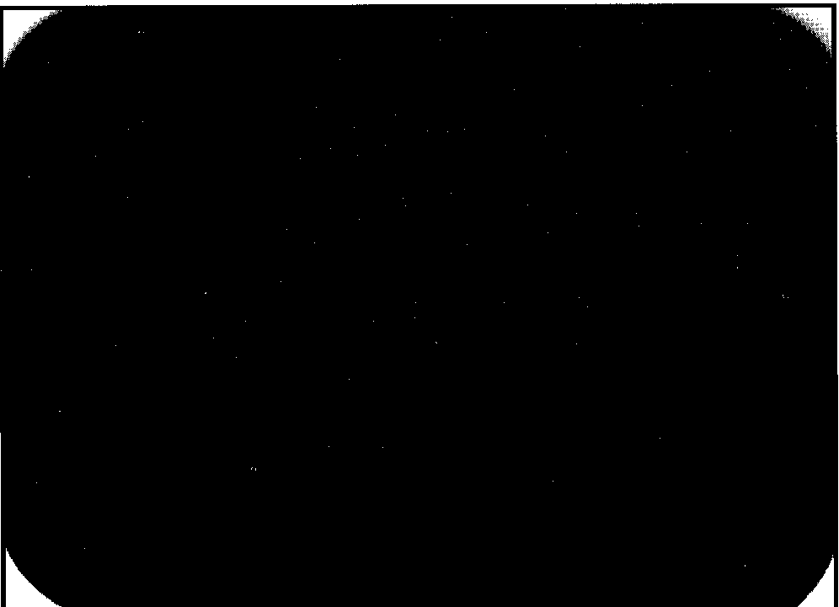
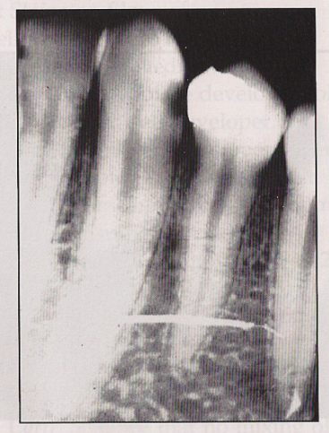
Error :: clear & black film; emulsion peel

Slide 79
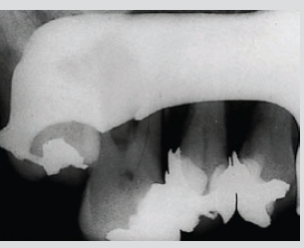

Slide 80
Thank You

